Slide 1


Git and Github
Git gud

Slide 2

Version Control System
VCS: A system of recording changes to files.
Write a novel yay!

Slide 3

A system that:
Records changes made
Can recover previous versions
Allows us to work independently in a team
Stores files in one place
Introducing
Git: A distributed VCS that takes ‘snapshots’ of your project.
GitHub: A platform to host & collab on repositories (project).

Slide 4
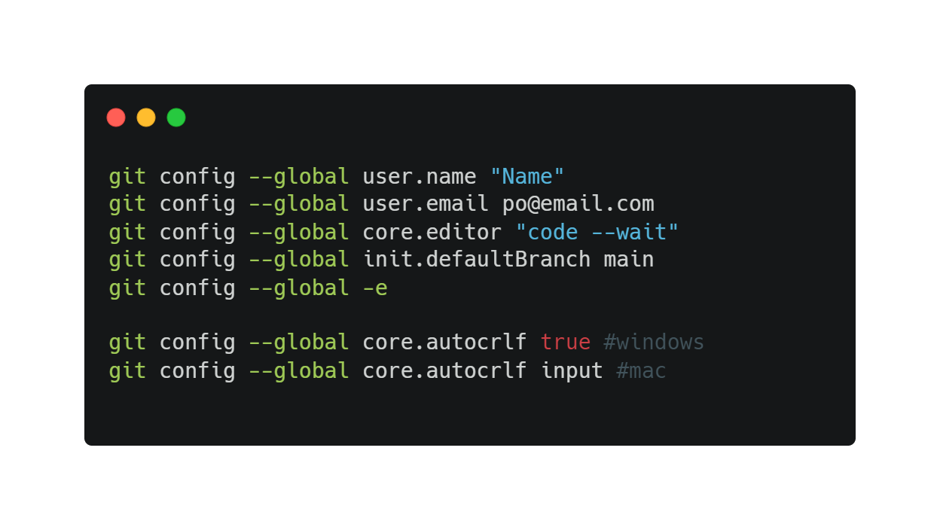
Installing & Configuring Git
Install Git for Windows or type git –-version in Mac terminal
Use GitBash (Windows) or terminal (Mac)
SYSTEM
All users
GLOBAL
All repos of current users
LOCAL
Current repo

Slide 5
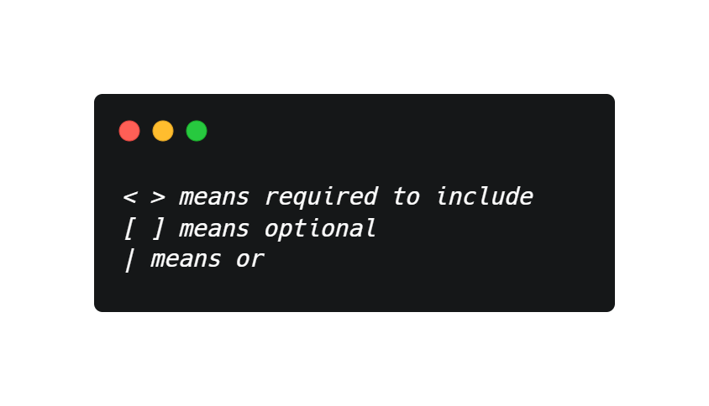
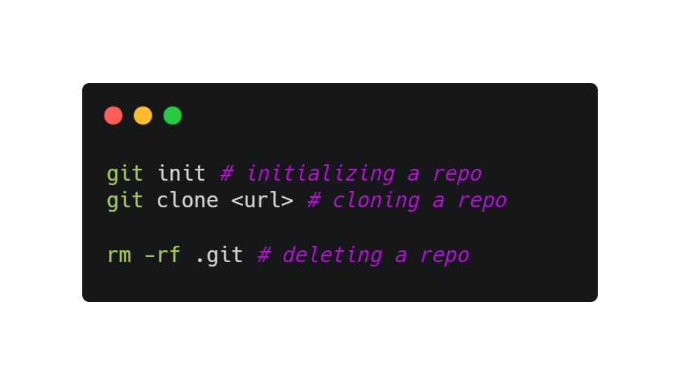
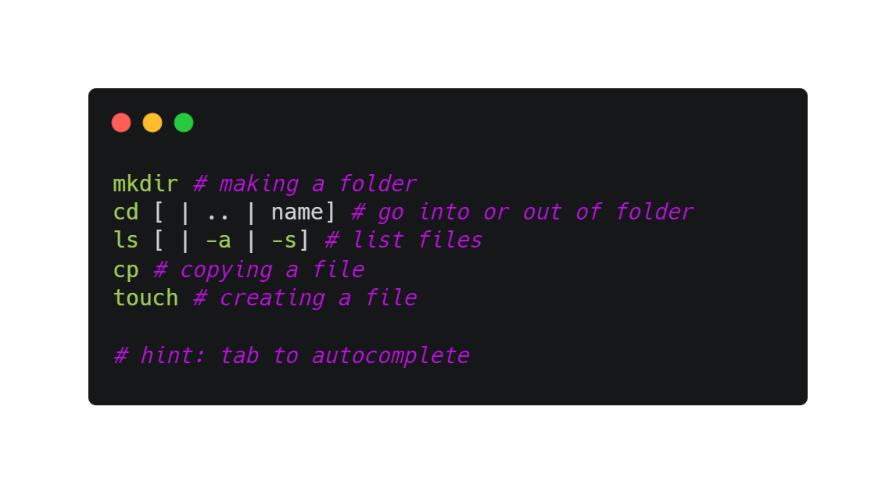
Initializing a Repo
A repository is a place to store all your project files.
Contains .git files (hidden)
Remote repository vs local repository

Slide 6
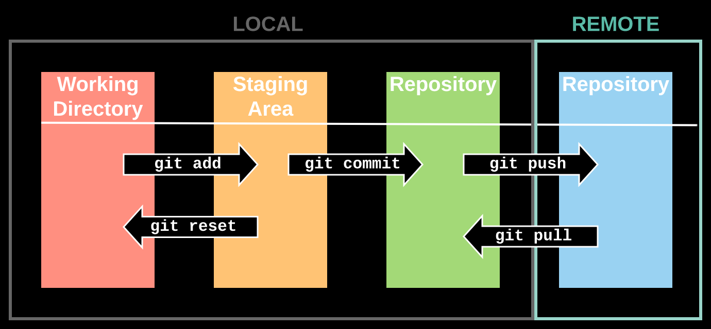
Git Workflow

Slide 7

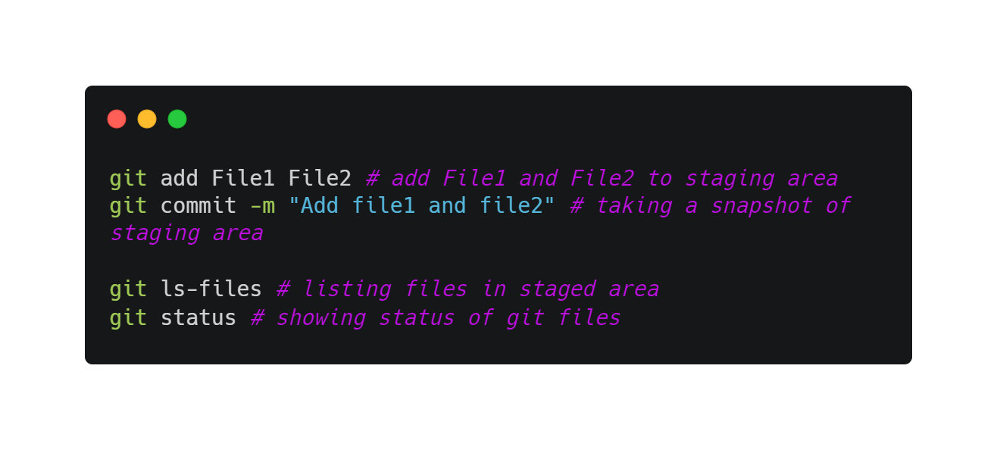
Flow
Staging area
Local repo
File 1
File 1
File 2
File 1
File 1
File 2
File 1
File 1
File 2
File 2

Slide 8
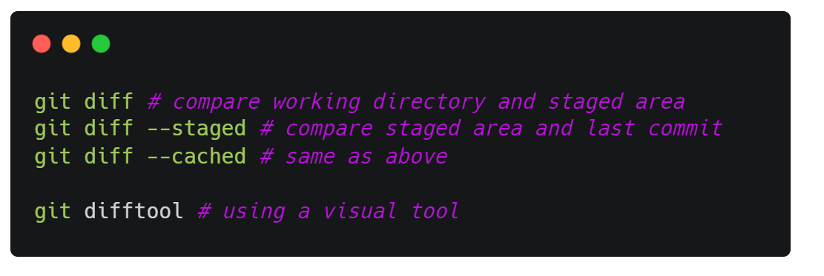
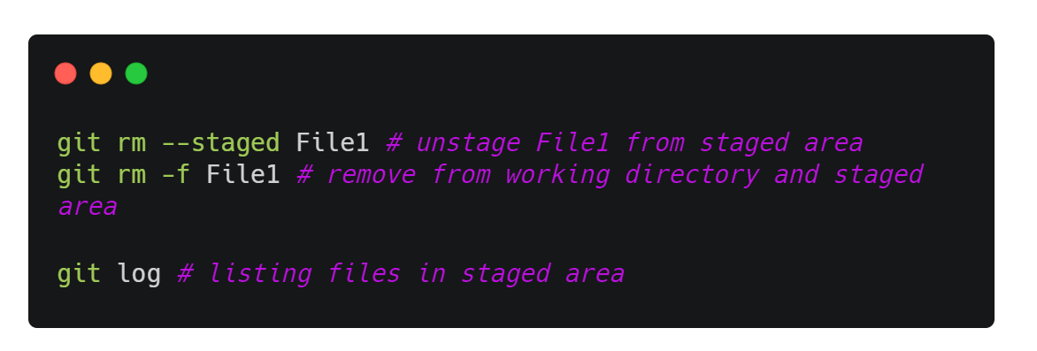
viewing changes
undoing changes
What happens if you remove the file from working directory?

Slide 9
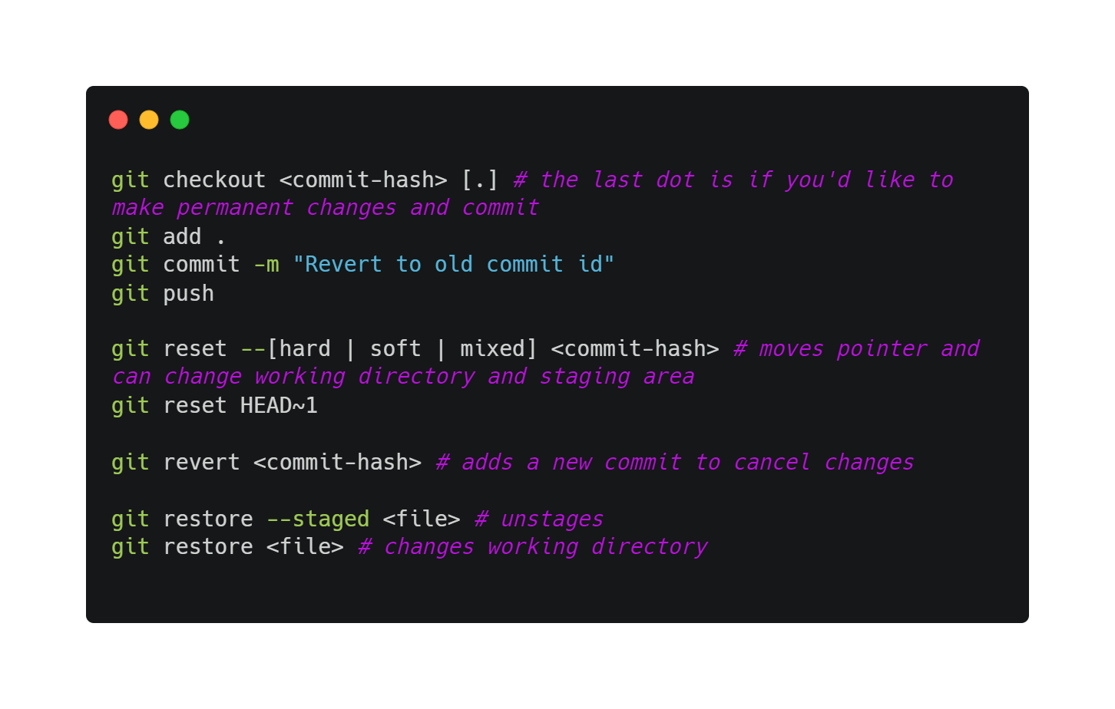
Restoring previous versions
Several methods to restore previous versions
git checkout
git reset
git revert
git restore

Slide 10
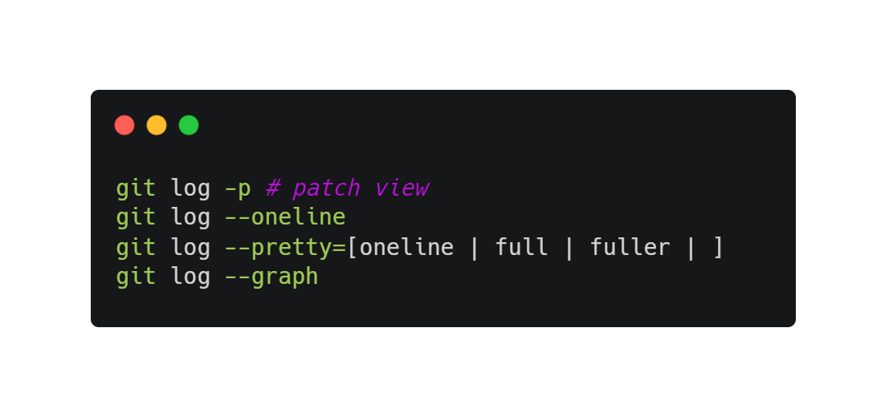
git log

Slide 11

Collaboration
Now, you want to collaboratively write a book.
Create title
Add paragraph 1
Add paragraph 2

Slide 12
Collaboration
Create and share your repo
What do you wanna do?
I’m doing a group project!
Open-source project

Slide 13
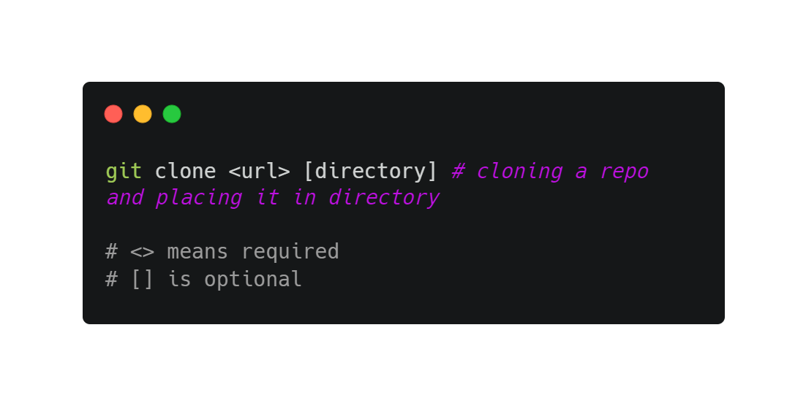
Cloning an existing repo
A full copy of nearly all data is retrieved
Includes all versions of the project
Why?

Slide 14
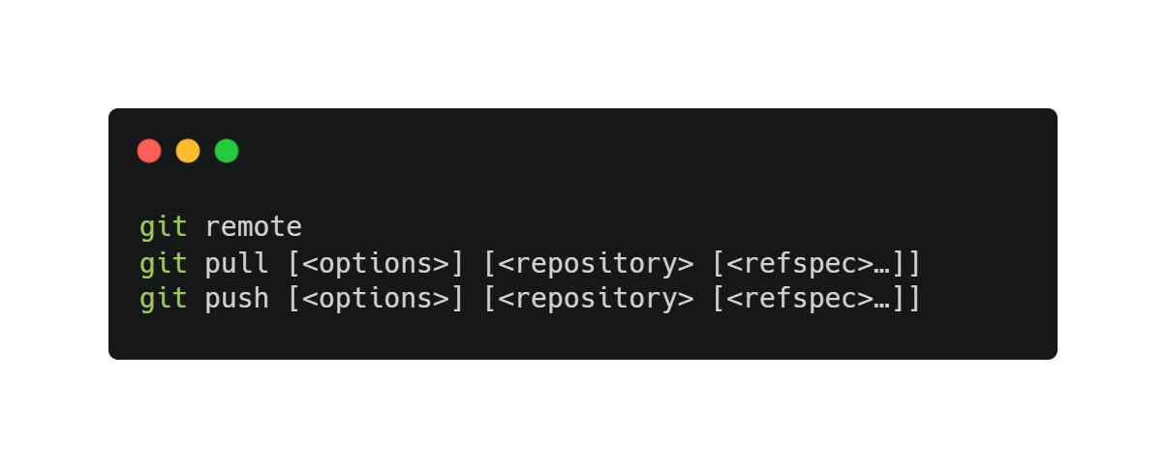
Remote repository, github!
Register an account on Github!
Origin refers to the remote repository’s name by convention.

Slide 15
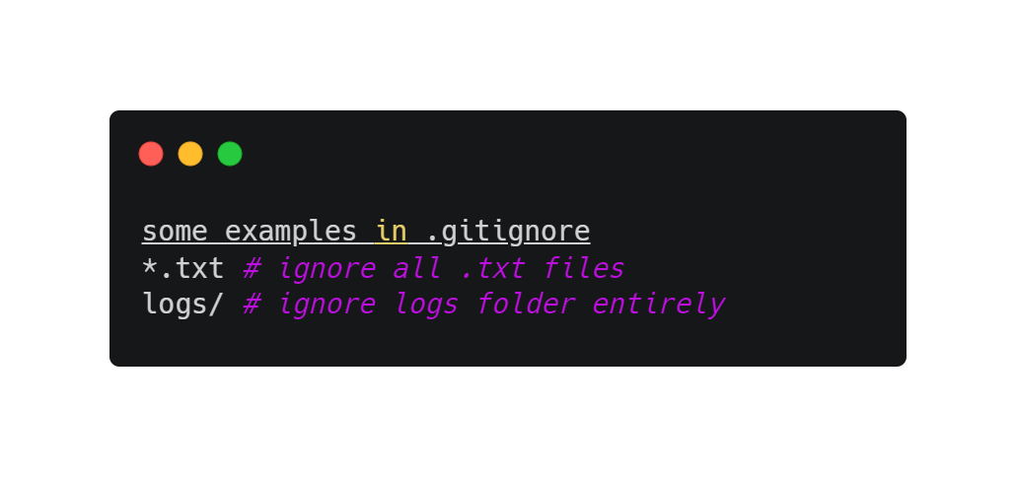
Common additional files
.gitignore is a way to ignore files in Git
README.md is to display text on GitHub

Slide 16
Authentication
https://docs.github.com/en/github/authenticating-to-github/connecting-to-github-with-ssh/about-ssh
SSH and HTTP

Slide 17
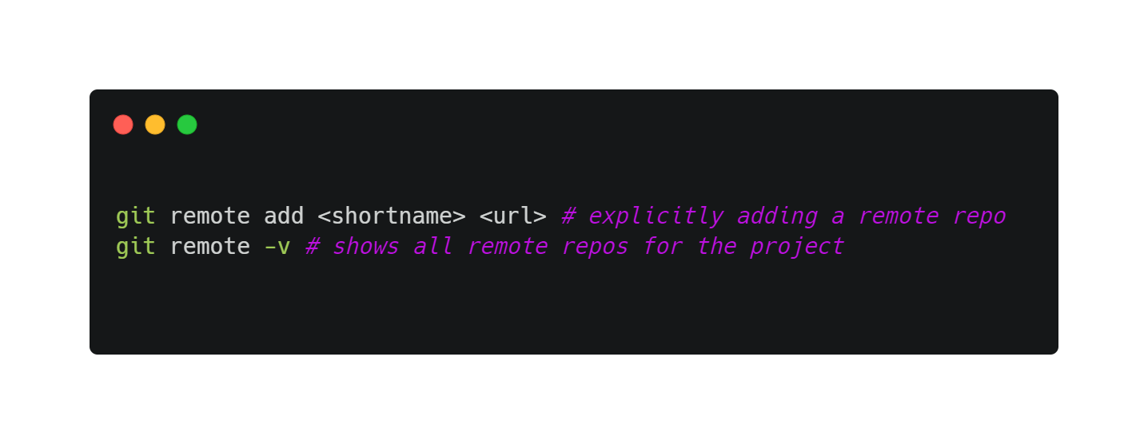
Adding a remote repository
git clone implicitly adds the remote repo for you under the name origin
To add one explicitly:

Slide 18
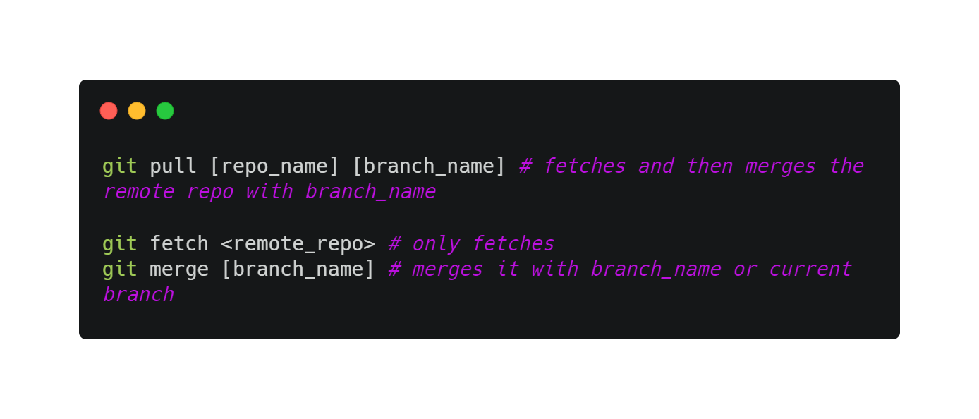
Fetching and pulling
git fetch command only downloads the data to your local repo but it does not merge or modify your work.
You have to do this manually.
git pull fetches the data and then merges that remote branch into your current branch. Additionally, git clone automatically sets up your local main branch to track the remote main branch.

Slide 19
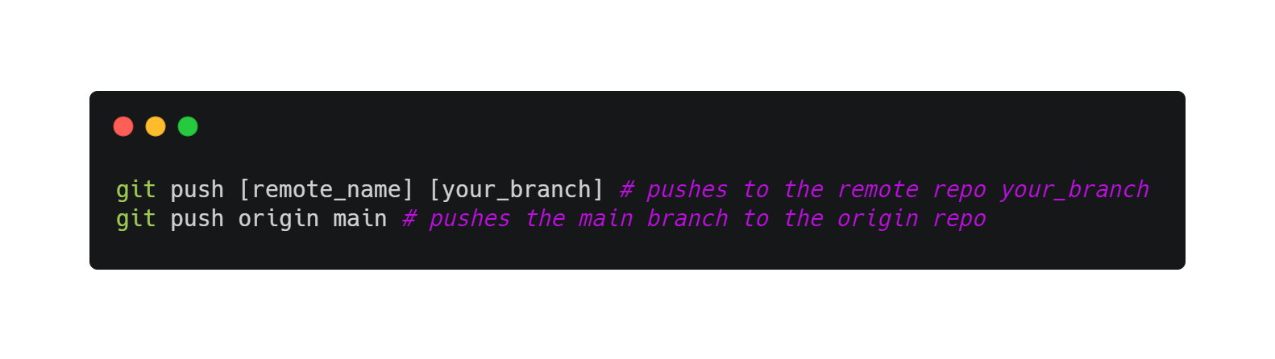
Pushing
Ready to share?
What happens when multiple people push at the same time? How about if you push before pulling?

Slide 20
Story so far

Slide 21
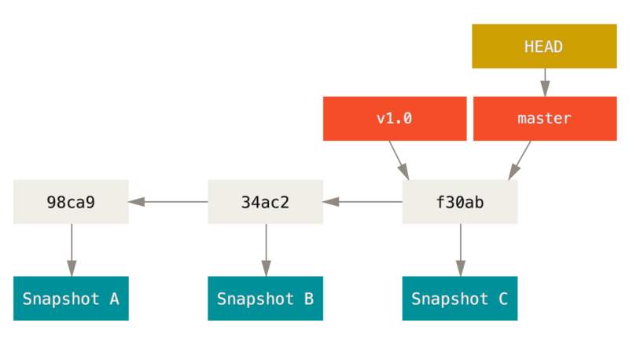
Branching
Diverge from the main development line and do your own stuff without messing the main line
Git stores snapshots, and a pointer that points to those snapshots

Slide 22
Branching
HEAD
Master
bc3ae
e39ae
s7bjk
d42ce
Switching branches changes your current working directory
test
test
HEAD
HEAD

Slide 23
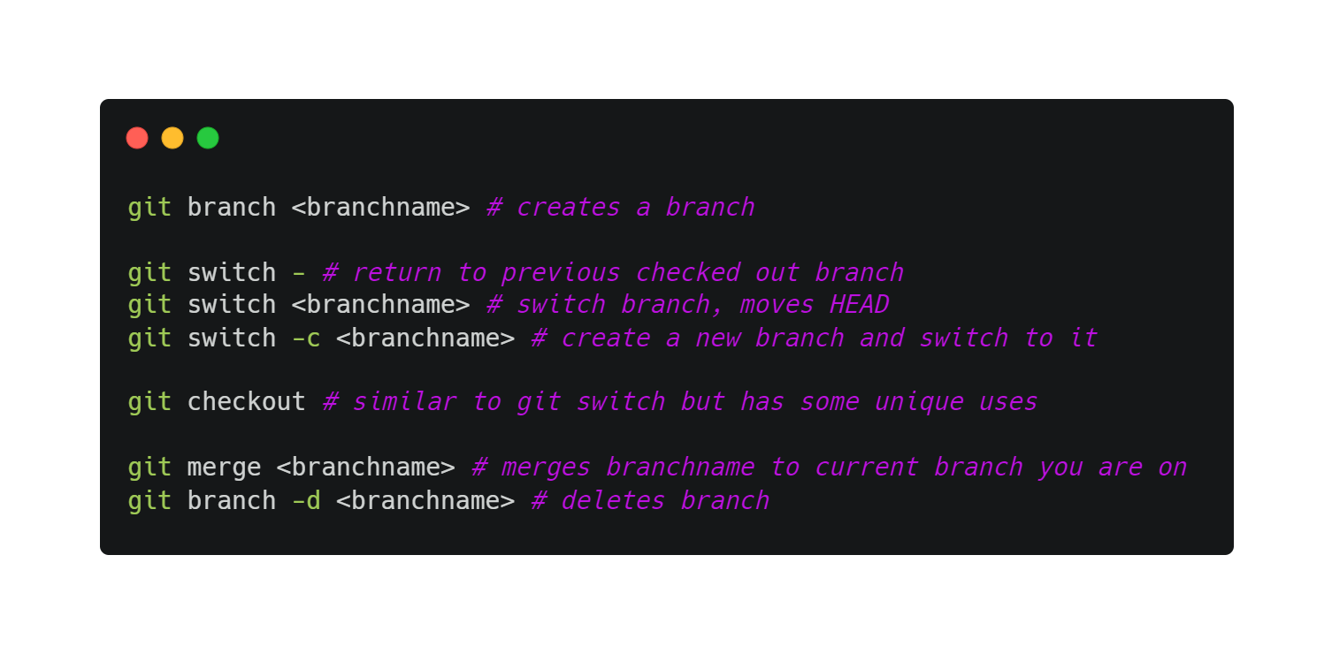
Branching
Switching branches changes your current working directory

Slide 24
Merge conflicts, pull requests, forking
Contributing to open source by forking:
i) Propose changes to someone’s project
ii) Use the code as your own project
iii) Does not affect original project

Slide 25
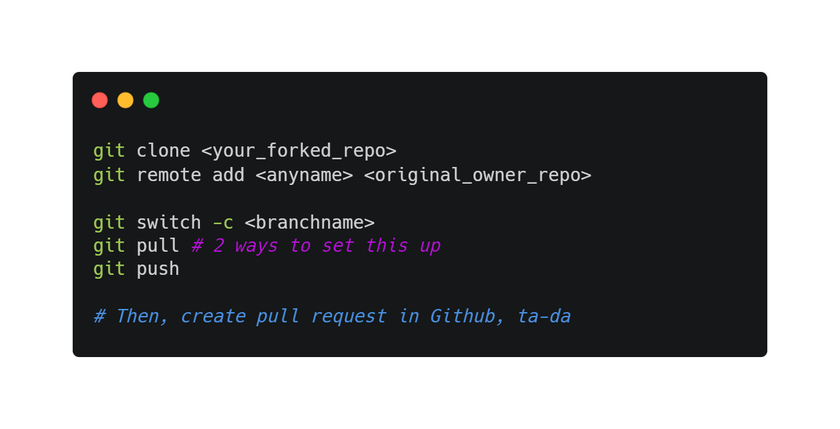
Merge conflicts, pull requests, forking
https://www.atlassian.com/git/tutorials/comparing-workflows/forking-workflow#:~:text=Forking%20is%20a%20git%20clone,org%2FuserA%2Fopen%2Dproject

Slide 26
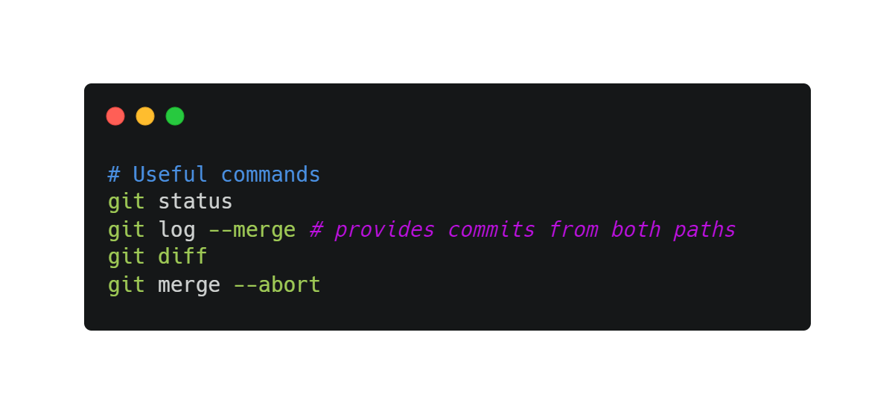
Merge conflicts, pull requests, forking
Once merge and conflict appears, open the file containing conflict
git add, then git commit

Slide 27

Git best practices!
Commit often!
Small but frequent commits
Commit related changes only (wrap related changes)
Commit completed changes
Meaningful commit messages

Slide 28
Resources
Pro Git Book
Bash commands
Not covered today
Rebasing, reverting, more advanced git commands
In-depth on how Git works
Git visual tools like GitKraken and VSCode git extension

Slide 29
Technical Issues
Configuring editor for Git (if you don’t use VSCode)

Slide 30
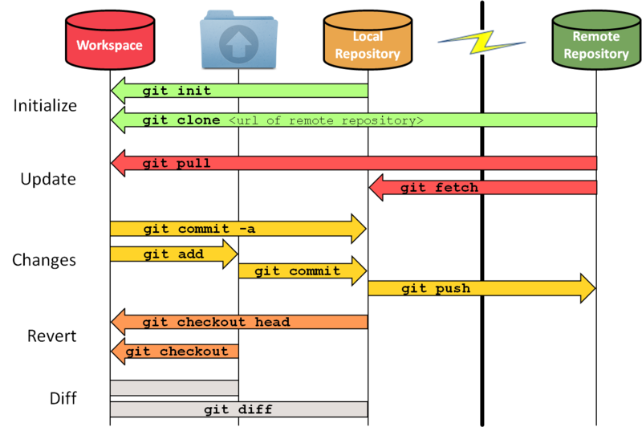
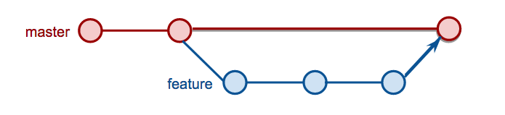
Add. slides/images
Untracked
unmodified
unmodified
Tracked
modified
staged
This Photo by Unknown Author is licensed under CC BY-SA
This Photo by Unknown Author is licensed under CC BY-NC

Slide 31
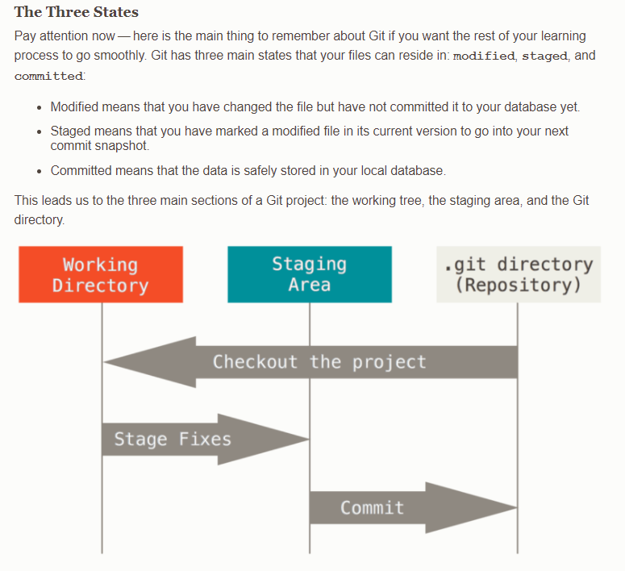
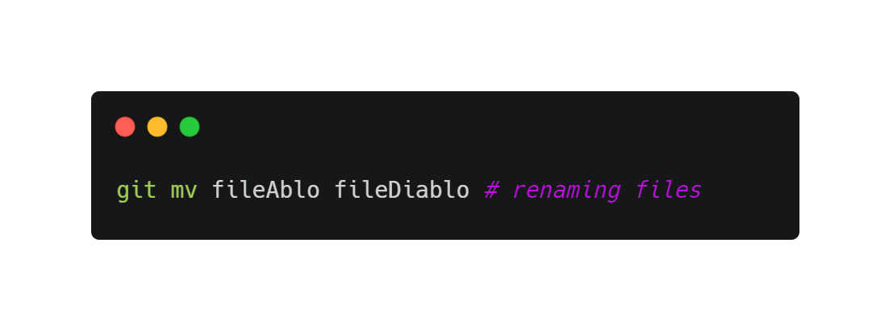
Add. slides/images

Slide 32
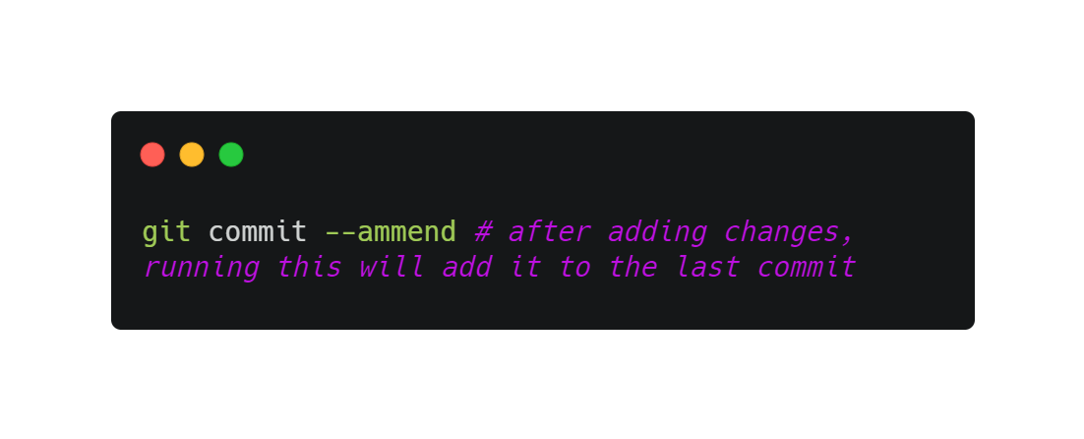
Add. slides/images

Slide 33
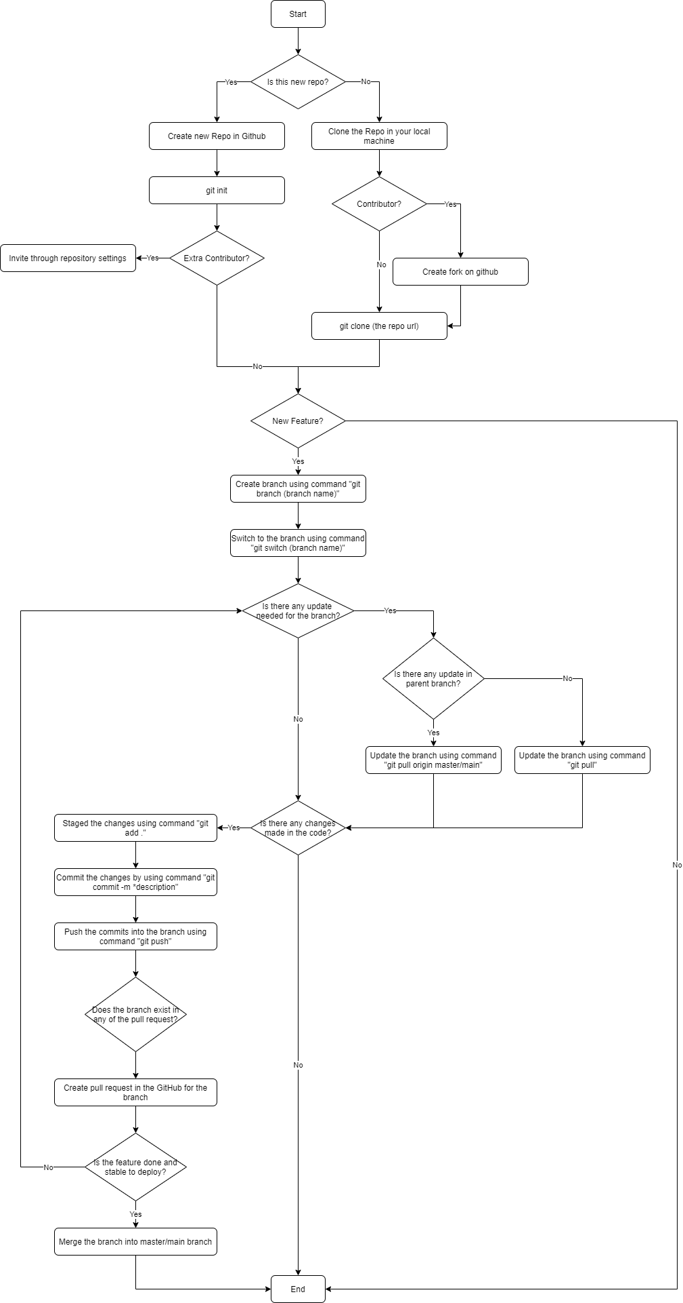
Add. slides/images

